Slide 1
South Florida and Best Management Practices
Manohardeep Josan
Post-doctoral Research Associate

Slide 2
Rules of the South Florida Water Management District
EVERGLADES PROGRAM
Chapter 40E-63, F.A.C.
Part I: Everglades Regulatory Program
Part II: Everglades Water Supply and Hydroperiod Improvement and Restoration
Part III: BMP Research, Testing and Implementation to Address Water Quality Standards
Notes:
2
2
Be informed of latest events regarding 10 ppb criteria……..

Slide 3
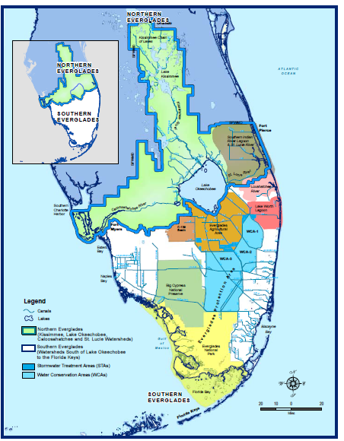
Source: SFWMD, 2012
Notes:
Major geographic features of the South Florida environment within the South Florida Water Management District’s boundaries

Slide 4
Part I: Everglades Regulatory Program
  1994 Everglades Forever Act
  Regulatory program goal: reduce EAA P loads by 25%
  EAA BMPs in place by February 1, 1995
  Master and individual BMP permits
  Compliance and enforcement procedures
  EAA load calculation methods
Notes:
4
4
The state of Fl enacted the Stoneman Douglass EP Act in 1991, which required the district to publish rule making allowing for permits authorizing discharge
The law was substantially revised in 1994.
The rule is based on the assumption that the implementation of the regulatory program for the EAA will not reduce the quantity of water discharged by more than 20% than the quantity historically discharged.

Slide 5
Part I: Everglades Regulatory Program
  Conditions for Permit Issuance/Renewal
    Submit BMP Plan-description, rationale, explanation, fertilization and water management for each crop, water management design, monitoring, education and training, schedule for implementation
    Submit WQ Plan-description of WQ monitoring program, map of locations, description of sample collection methods, flow calculation methods, QA/QC, data mgt, data submittal
Notes:
5
5
Without permit there would be no drainage pumping; no farming. Permits are needed to farm in the EAA.
District collect monitoring data from the EAA basin starting Jan 1, 1995 to determine compliance with P load reduction regulation.

Slide 6
Establishment of BMP’s
The University of Florida (UF) initiated BMP research in 1986
It was alleged that Phosphorous (P) in agricultural drainage water leaving the EAA was negatively impacting downstream water quality and surrounding ecosystems
P in fertilizer was believed by ‘many’ to be the primary source of elevated P concentrations

Slide 7
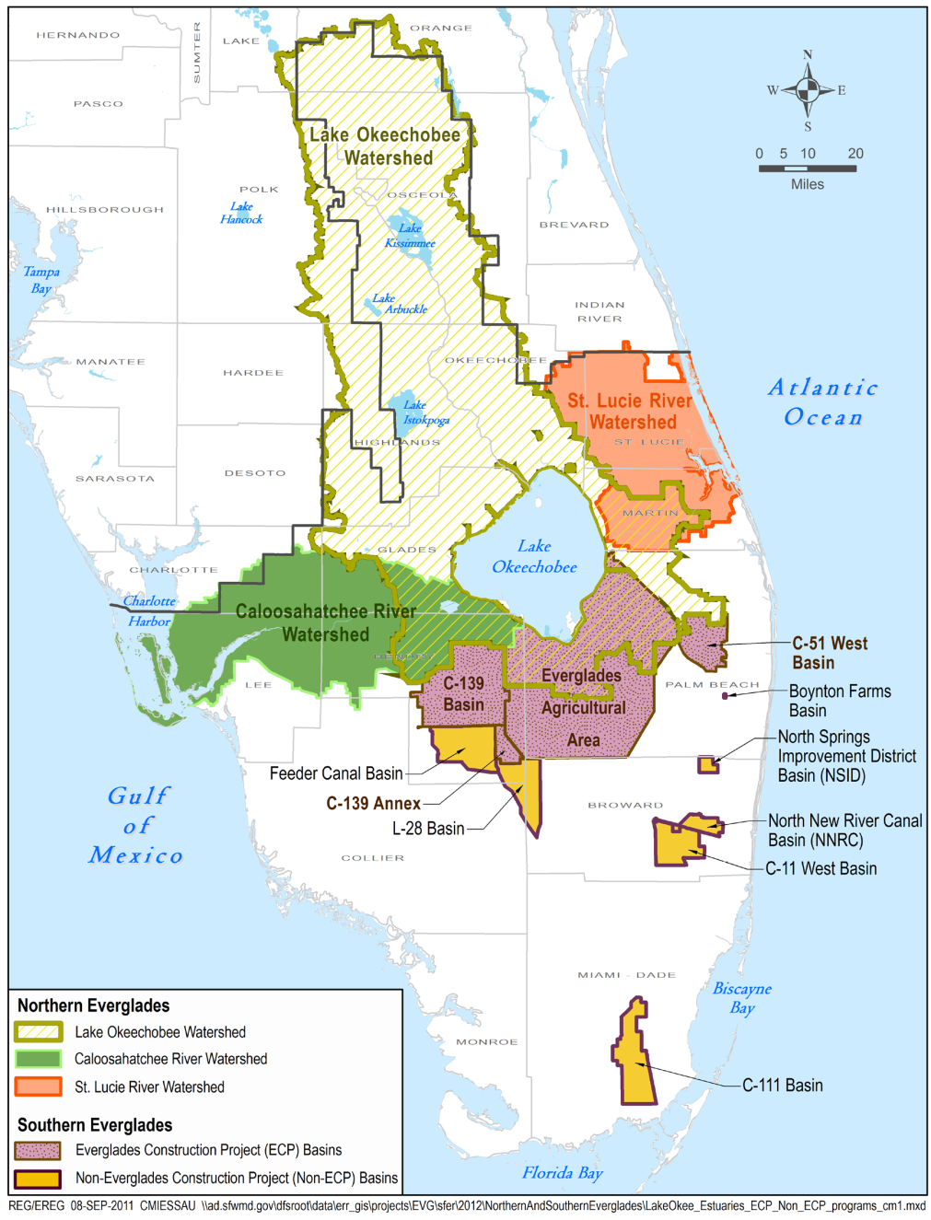

The Northern Everglades and Southern Everglades source control program implementation areas.

Slide 8
BMP Research
Research done by UF determined that fertilizer practices and a combination of improved drainage uniformity and a reduction in drainage pumping could result in P load reductions of 20 to 60%
BMP’s suggested by UF and others were selected by the SFWMD for inclusion into a table of BMP options for EAA growers
This BMP table became part of a regulatory program initiated by the SFWMD

Slide 9
SFWMD BMP Definition
Agricultural Best Management Practices (BMPs) are practical, cost-effective actions that agricultural businesses can use to reduce pesticides, fertilizers, animal waste and other pollutants entering our water resources.
BMPs are designed to protect or improve water quality while maintaining or even enhancing agricultural production.
The Florida Department of Agriculture and Consumer Services (FDACS) and the Florida Department of Environmental Protection (DEP) develop and adopt BMPs by rule for different types of agricultural operations.

Slide 10
Working Definition of BMP
“An alternative management practice that is technically feasible, economically viable, socially acceptable, and scientifically sound, and when implemented, will lead to reduced P concentrations and loads leaving farms in the EAA, while not threatening the viability of the agricultural production system”.

Slide 11
Determining P Load
P LOAD = DRAINAGE VOLUME X P CONC
Concentration of P in farm drainage water
  Soil oxidation (subsidence)
  Fertilizer application
  Detritus from FAV
Volume of drainage water pumped off-farm
  Rainfall: amount and distribution
  Drainage needs of crop
  Irrigation quantity (and quality)
  Seepage into and off farm

Slide 12
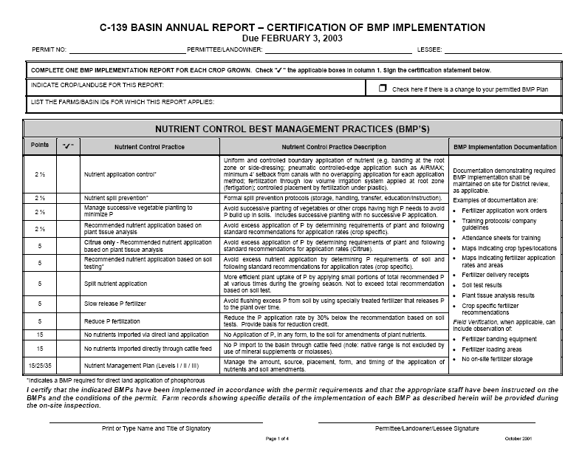

Slide 13
BMP | PTS | DESCRIPTION
NUTRIENT CONTROL: MINIMIZE MOVEMENT OF NUTRIENTS OFF-SITE
Nutrient Application Control | 2½ | Controlled application of nutrients; banding, controlled application
Nutrient Spill Prevention | 2½ | Formal spill protocols: storage, handling, transfer, and education/instruction
Rotational Vegetable Planting | 2½ | Rotation planting of high P/low P demand crops to avoid P build up
Plant Tissue Analysis | 2½ | Determines plant nutrient requirements via tissue testing
Soil Test Based Fertilization | 5 | Determine soil P requirements and follow standard recommendations
Split Nutrient Application | 5 | Applying split P without exceeding total recommendation
Slow Release P Fertilizer | 5 | Specially treated fertilizer
Reduced P Fertilization | 5 | P application rate is at least 30% below recommendation
WATER MANAGEMENT: MINIMIZE THE VOLUME OF OFF-SITE DRAINAGE DISCHARGE
½ Inch Detained | 5 | Delay discharge: based on measuring daily rain events using a rain gauge
1 Inch Detained | 10 | Delay discharge: based on measuring daily rain events using a rain gauge
Improved Infrastructure | 5 | Re-circulate water; fallow field flood; increase water detention
Water Table Management | 5 | Optimizing drainage and irrigation schedules to decrease discharge
PP AND SEDIMENTS: MINIMIZE MOVEMENT OF PARTICULAT MATTER AND CANAL SEDIMENTS
Any 2 Any 4 Any 6 Any 8 | 2½ 5 10 15 | • Leveling fields • Slow drainage velocity near pumps • Grassed swales/field ditch connections • Ditch bank berms • Canal cleaning program • Aquatic weed control • Field ditch drainage sumps • Barriers at discharge locations • Ditch bank stabilization • Sediment sump/trap in canals • Soil stabilization through infrastructure improvements • Cover crops • Culvert bottoms above ditch bottoms • Vegetated ditch banks
Other BMPs | TBD | BMPs proposed by permittee and accepted by SFWMD

Slide 14
Example: Sugarcane Farm Deep Soil
BMP | Points
1” Rainfall detention | 10
Controlled fertilizer application | 2.5
Fertilizer spill prevention | 2.5
Soil testing program | 5
Sediment controls (4) | 5
Total | 25
Level fields | Field ditch sumps
Canal cleaning | Cover crops

Slide 15
Example: Sugarcane Farm Shallow Soil
BMP | Points
1/2” Rainfall detention | 5
Controlled fertilizer application | 2.5
Fertilizer spill prevention | 2.5
Soil testing program | 5
Sediment controls (6) | 10
Total | 25
Level fields | Field ditch sumps
Ditch bank berms | Raised culverts
Main canal sump | Riser boards

Slide 16
Nutrient Control BMPs
Soil Testing and Plant Tissue Analysis
Fertilizer application
  Fertilizer misapplication
Spill Prevention

Slide 17
Soil Testing
Part of the “Nutrient Control Practices” listed under approved BMPs for water quality improvement in the EAA.
Soil testing is an essential tool to formulate a sound lime and nutrient management program.
With increased emphasis on environmental quality and rising cost of fertilizer materials, soil testing has become an important tool to identify areas where inadequate or excess fertilization has occurred.

Slide 18
Relationship Between Soil Test P, Crop Yield, and Potential for Environmental Problems due to Excessive Soil P
Potential Environmental Problems
L
M
H
Excessive

Slide 19
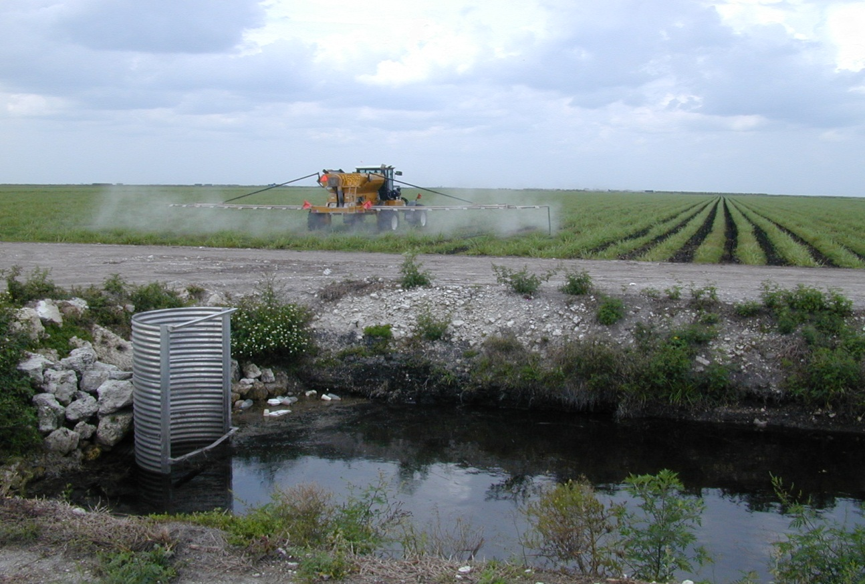
Fertilizer Application
3 Goals of Fertilizer Application BMPs
Fertilize to cover all crop needs
Reduce over- or misapplication
Eliminate spills, cleanup spills

Slide 20
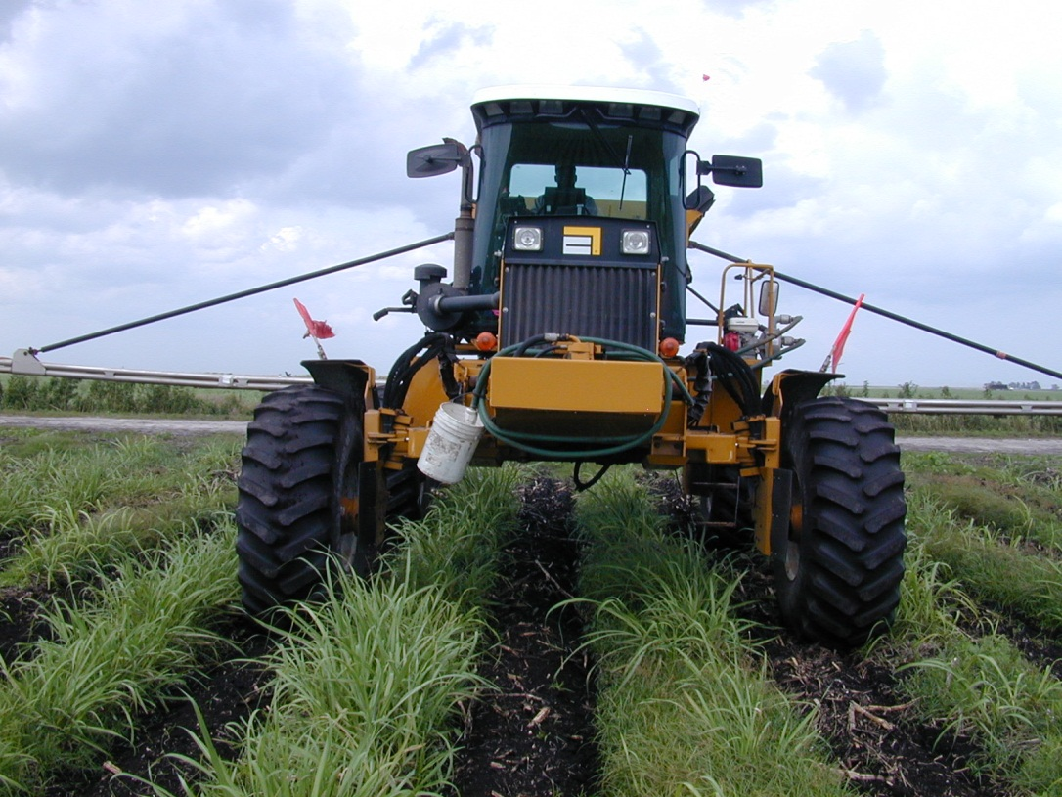
Apply minimum amount of P fertilizer that is needed to produce optimum yields
Increase fertilizer use efficiency
Timing of fertilizer application/split applications
Placement of fertilizer close to root zone
Fertilizer sources: soluble/slow release fertilizers

Slide 21
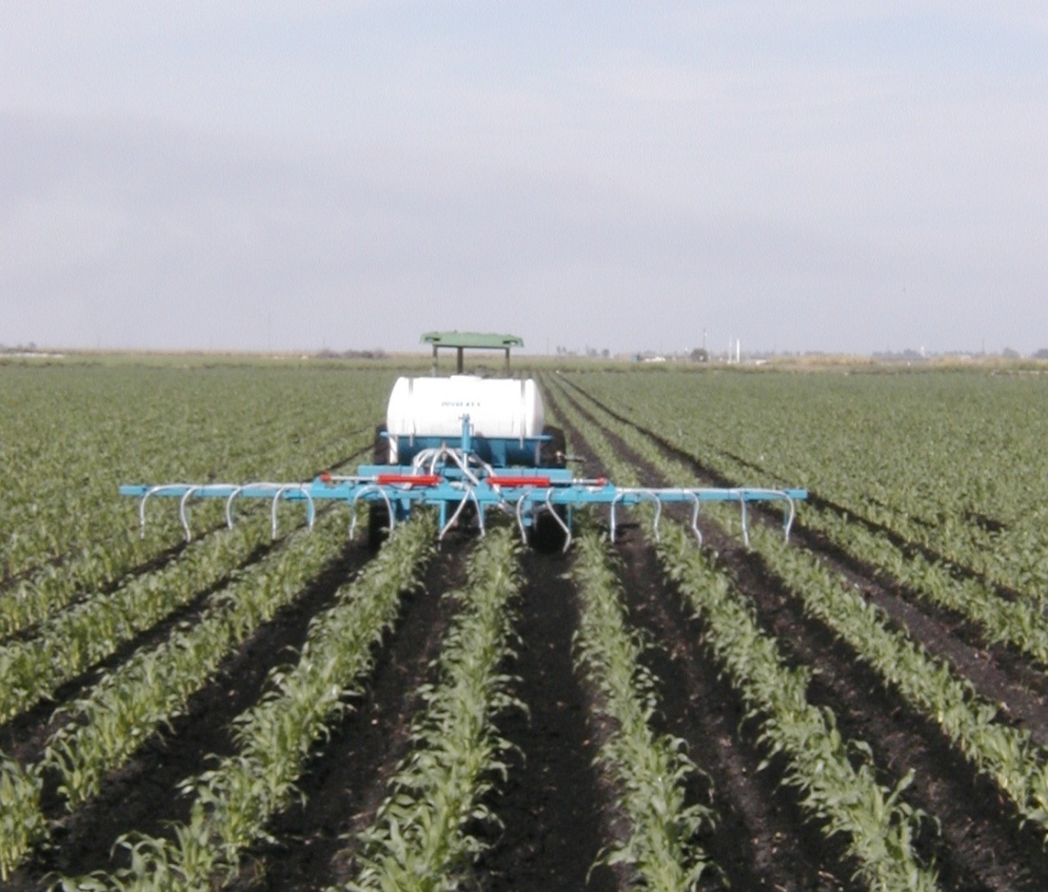
Banding of P Fertilizers
Places fertilizer close to the root zone; more efficient uptake by plant.
Reduces the soil-fertilizer surface contact area, resulting in less P fixation.
Reduces likelihood of overlapping application to same rows.
The most important advantage of banding is the significant reduction of the overall amount of P applied especially to vegetables.

Slide 22
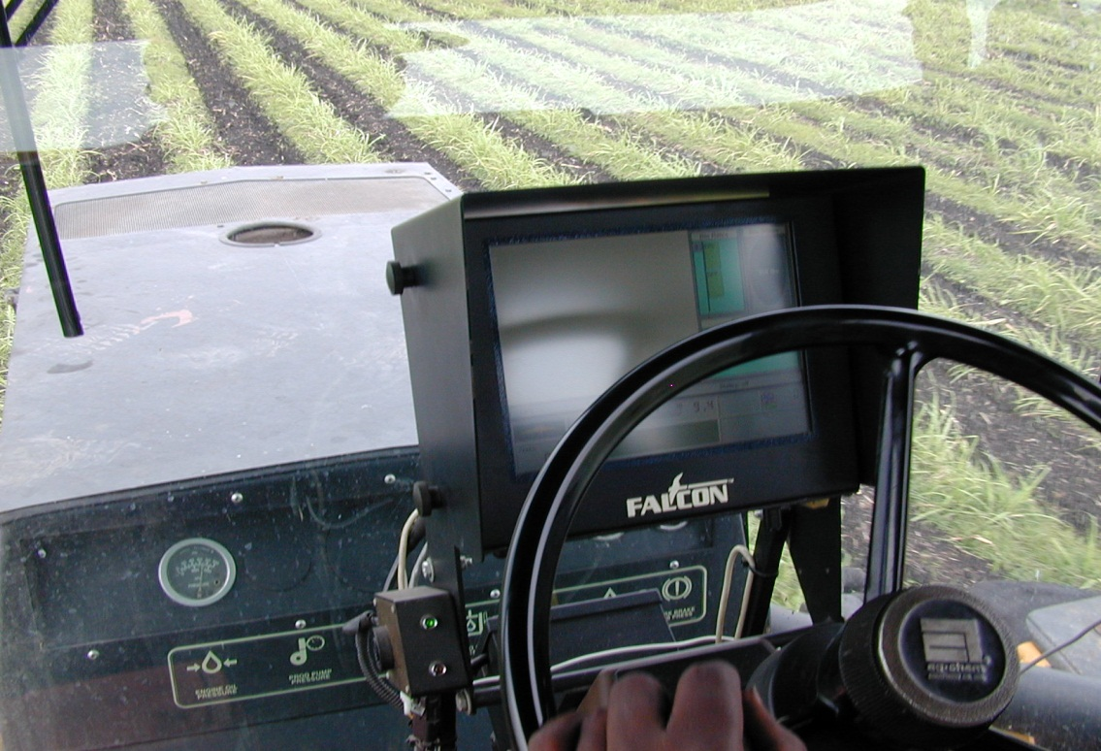
Fertilizer Misapplication Prevention
Tune/Calibrate Equipment
Before planting season starts
Monitor actual application rates vs. calculated amounts

Slide 23
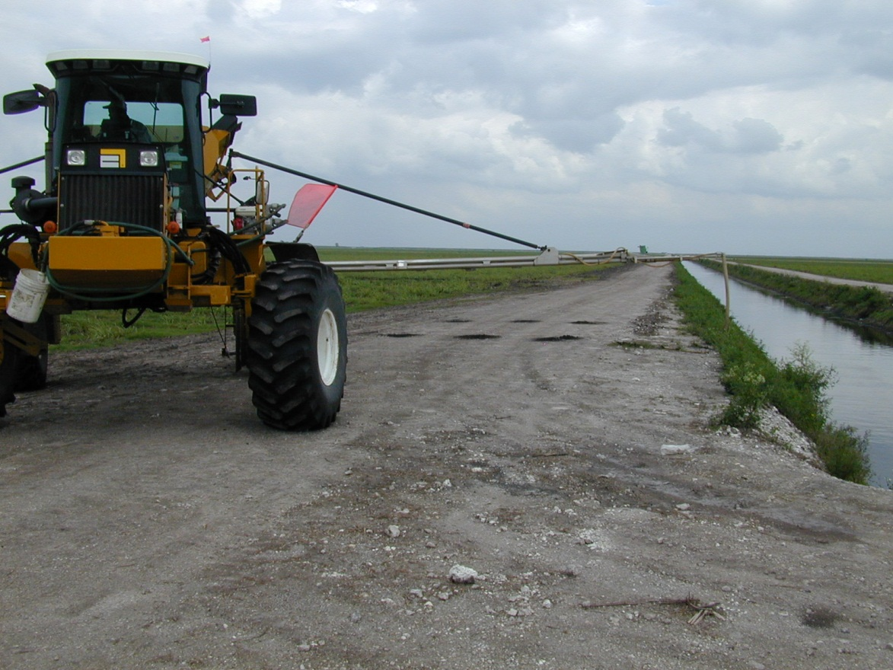
Fertilizer Misapplication Prevention
Reduce Turning Speed
Never broadcast fertilizer near canals

Slide 24
Fertilizer Spill Prevention
Park fertilizer hoppers/trailers and field application rigs far away from ditch/canal banks.
Park fertilizer hoppers/trailers on level ground (avoid slopes leading to open water).
Limit the number of loading sites … easier to “police”.
Properly train all personnel involved in handling fertilizer material.
Policy: Park fertilizer hopper/trailers ONLY at sugarcane loading ramp sites.

Slide 25
Loading Site on Level Ground

Slide 26
Dealing With Fertilizer Spills
Contain spills on tarps placed under/between trailer and application rigs.
Have buckets/shovels available for immediate clean-up.
Sweep “mini-spills” off trailer/hopper onto tarp and apply soil/dirt/fertilizer clean-up mix in target field.
Policy: All personnel involved in handling and spreading fertilizer should have a copy of the Standard Operating Procedures (SOP) on handling fertilizer spills.

Slide 27
Nutrient BMPs
Nutrient BMPs very successful and economical
Requires proper annual training of personnel
Research on fertilizer use efficiency invaluable:
  Fertilizer sources – slow release, micros, etc.
  Soil fertility – pH effects, cycling, soil extractants, etc.
  Crop nutrition – leaf analysis, supplemental, etc.

Slide 28
Water Management BMPs
BMP | PTS | DESCRIPTION
NUTRIENT CONTROL: MINIMIZE MOVEMENT OF NUTRIENTS OFF-SITE
Nutrient Application Control | 2½ | Controlled application of nutrients; banding, controlled application
Nutrient Spill Prevention | 2½ | Formal spill protocols: storage, handling, transfer, and education/instruction
Rotational Vegetable Planting | 2½ | Rotation planting of high P/low P demand crops to avoid P build up
Plant Tissue Analysis | 2½ | Determines plant nutrient requirements via tissue testing
Soil Test Based Fertilization | 5 | Determine soil P requirements and follow standard recommendations
Split Nutrient Application | 5 | Applying split P without exceeding total recommendation
Slow Release P Fertilizer | 5 | Specially treated fertilizer
Reduced P Fertilization | 5 | P application rate is at least 30% below recommendation
WATER MANAGEMENT: MINIMIZE THE VOLUME OF OFF-SITE DRAINAGE DISCHARGE
½ Inch Detained | 5 | Delay discharge: based on measuring daily rain events using a rain gauge
1 Inch Detained | 10 | Delay discharge: based on measuring daily rain events using a rain gauge
Improved Infrastructure | 5 | Re-circulate water; fallow field flood; increase water detention
Water Table Management | 5 | Optimizing drainage and irrigation schedules to decrease discharge
PP AND SEDIMENTS: MINIMIZE MOVEMENT OF PARTICULAT MATTER AND CANAL SEDIMENTS
Any 2 Any 4 Any 6 Any 8 | 2½ 5 10 15 | • Leveling fields • Slow drainage velocity near pumps • Grassed swales/field ditch connections • Ditch bank berms • Canal cleaning program • Aquatic weed control • Field ditch drainage sumps • Barriers at discharge locations • Ditch bank stabilization • Sediment sump/trap in canals • Soil stabilization through infrastructure improvements • Cover crops • Culvert bottoms above ditch bottoms • Vegetated ditch banks
Other BMPs | TBD | BMPs proposed by permittee and accepted by SFWMD

Slide 29
Definitions
Detention: temporarily holding water until conditions for release are met; object is to control discharge rates to reduce impact on downstream receiving systems.
Retention: preventing water from discharging into receiving waters; water is held until it is lost to percolation, evapotranspiration or evaporation.
EAA Detention BMP is a hybrid of detention and retention

Slide 30
Rainfall Detention
Goal: reduce volume of water pumped off-farm
Benefits: less soil subsidence + lower P conc
Risks: higher WTs may harm crop, reduce yields
Processes: ET, seepage, water tolerant crops
Unknown: subsurface drainage/seepage shellrock
Effective, versatile, and completely farm-specific

Slide 31
Water Detention Methods
Rainfall detention
Selected fields with high/low water tables
  Booster pumps, gates, culverts
On-farm water storage areas
  Retention pond
  Seasonally flooded fields or blocks
Higher water tables across whole farm
  Use of water tolerant crops/varieties
  Regulated pumping practices

Slide 32
Regulated Pumping

Slide 33
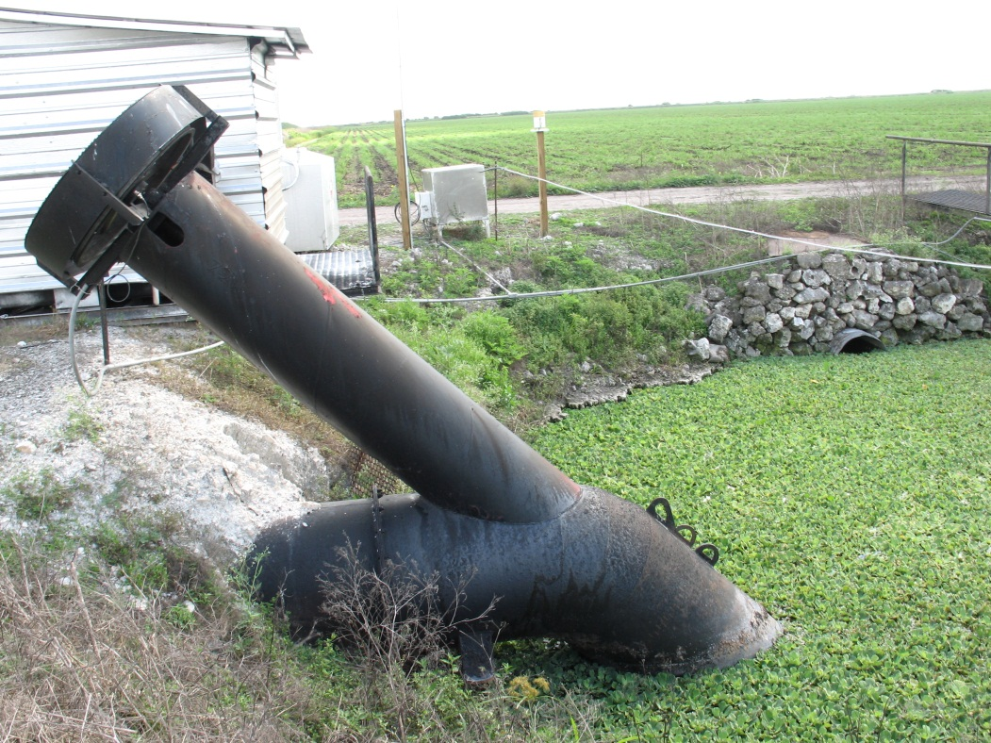
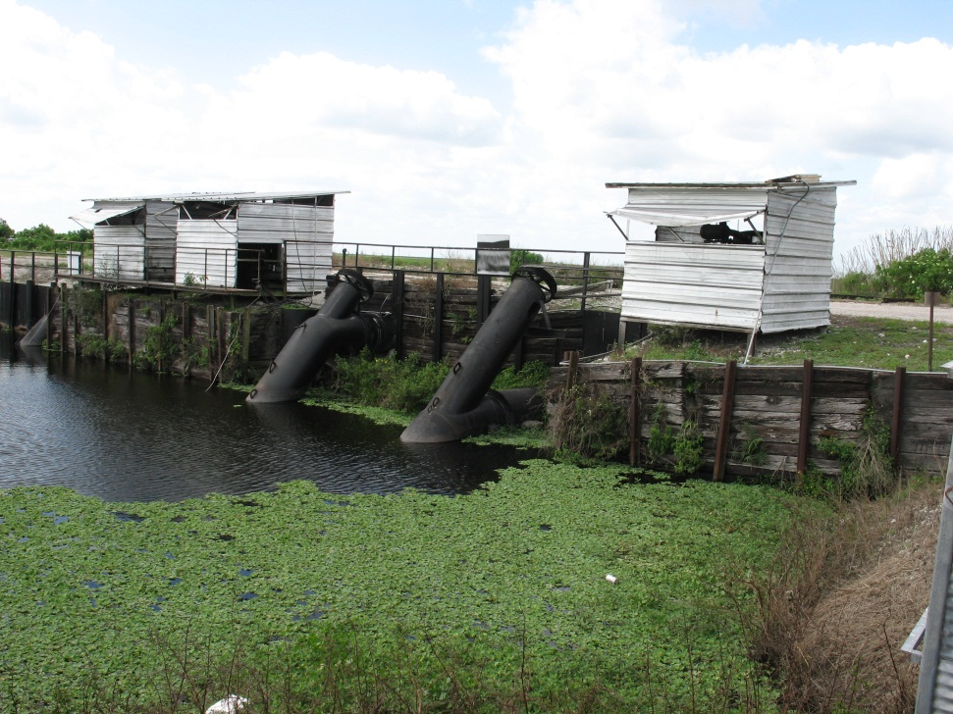

Slide 34
Pumping Exceptions
Seepage
Irrigation followed by unexpected rainfall
Late control of prior rainfall
Cultural practice: planting or harvesting
Weed cultivation or ground spraying operations
Removal of fire control water
Removal of water from flooded fallow/rice fields
Approach of large storm system
Land prep or laser plane operations

Slide 35
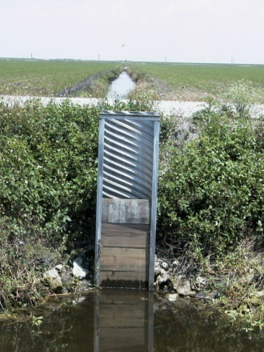
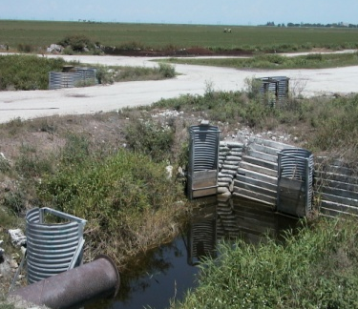
- Coordinate crop rotations within contiguous
field blocks.
Sod
- Install water control structures to allow
independent WT management.
Leaf
- Drain veggies fields first, then operate main
discharge pumps only if needed.
Cane
Lowest P loads
Hydraulic blocking of
like crops + independent
WT control achieves the
greatest potential for reducing
off-farm drainage loads.

Slide 36
Sediment control practices

Slide 37
BMP | PTS | DESCRIPTION
NUTRIENT CONTROL: MINIMIZE MOVEMENT OF NUTRIENTS OFF-SITE
Nutrient Application Control | 2½ | Controlled application of nutrients; banding, controlled application
Nutrient Spill Prevention | 2½ | Formal spill protocols: storage, handling, transfer, and education/instruction
Rotational Vegetable Planting | 2½ | Rotation planting of high P/low P demand crops to avoid P build up
Plant Tissue Analysis | 2½ | Determines plant nutrient requirements via tissue testing
Soil Test Based Fertilization | 5 | Determine soil P requirements and follow standard recommendations
Split Nutrient Application | 5 | Applying split P without exceeding total recommendation
Slow Release P Fertilizer | 5 | Specially treated fertilizer
Reduced P Fertilization | 5 | P application rate is at least 30% below recommendation
WATER MANAGEMENT: MINIMIZE THE VOLUME OF OFF-SITE DRAINAGE DISCHARGE
½ Inch Detained | 5 | Delay discharge: based on measuring daily rain events using a rain gauge
1 Inch Detained | 10 | Delay discharge: based on measuring daily rain events using a rain gauge
Improved Infrastructure | 5 | Re-circulate water; fallow field flood; increase water detention
Water Table Management | 5 | Optimizing drainage and irrigation schedules to decrease discharge
PP AND SEDIMENTS: MINIMIZE MOVEMENT OF PARTICULAT MATTER AND CANAL SEDIMENTS
Any 2 Any 4 Any 6 Any 8 | 2½ 5 10 15 | • Leveling fields • Slow drainage velocity near pumps • Grassed swales/field ditch connections • Ditch bank berms • Canal cleaning program • Aquatic weed control • Field ditch drainage sumps • Barriers at discharge locations • Ditch bank stabilization • Sediment sump/trap in canals • Soil stabilization through infrastructure improvements • Cover crops • Culvert bottoms above ditch bottoms • Vegetated ditch banks
Other BMPs | TBD | BMPs proposed by permittee and accepted by SFWMD

Slide 38
Sediment BMPs
Field leveling | Raised culverts
Ditch bank berms | Canal cleaning
Sediment sump | Upstream pump sump
Grassed ditch banks | Drainage ditch sump
Cover crops | Weed/trash boom
Controlled drainage | Other controls

Slide 39
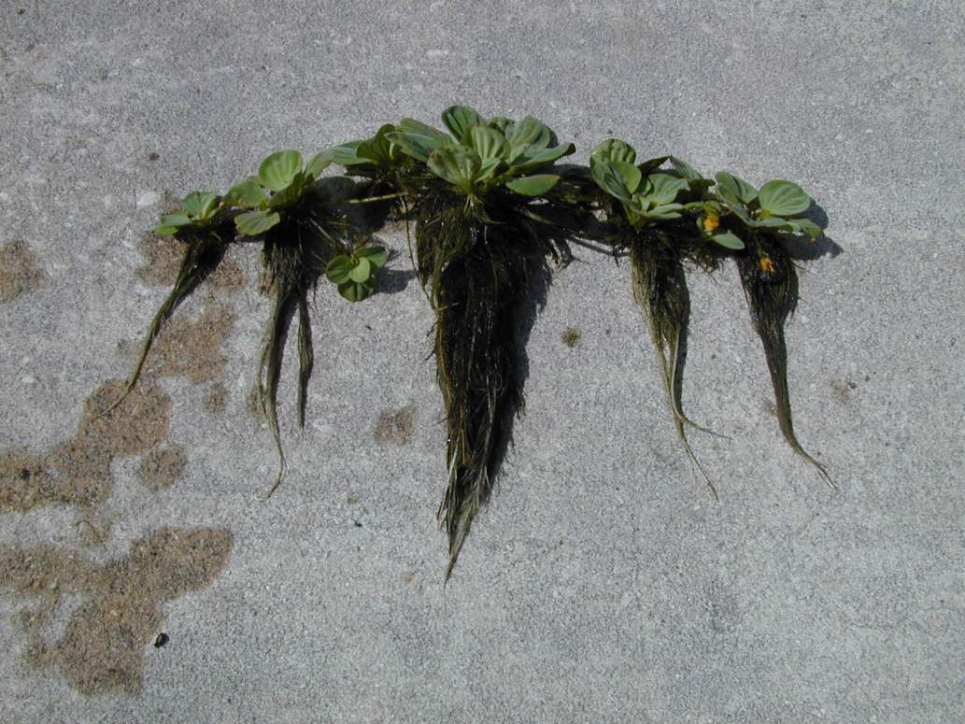
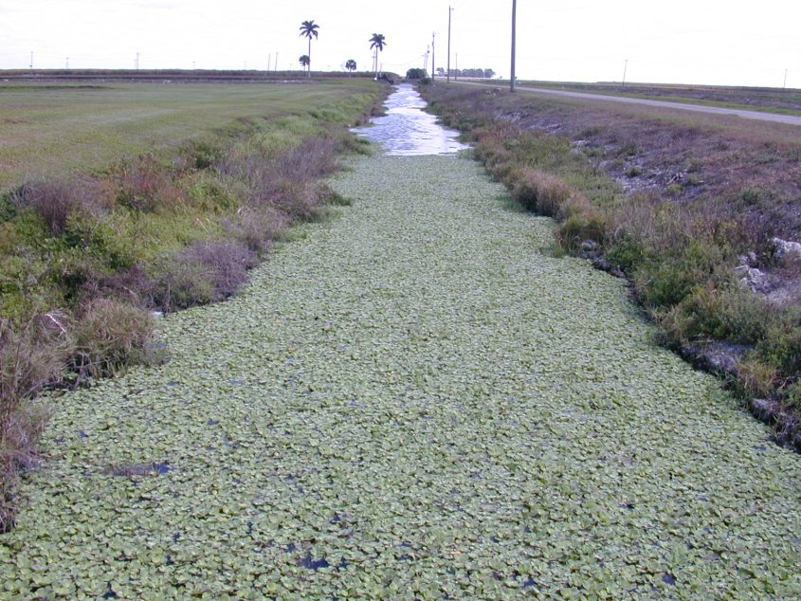
Particulate Phosphorus
Any P-Containing Matter with Particle Size Greater than 0.45 micron
Covers Broad Range from Protozoa to Tree Branches

Slide 40
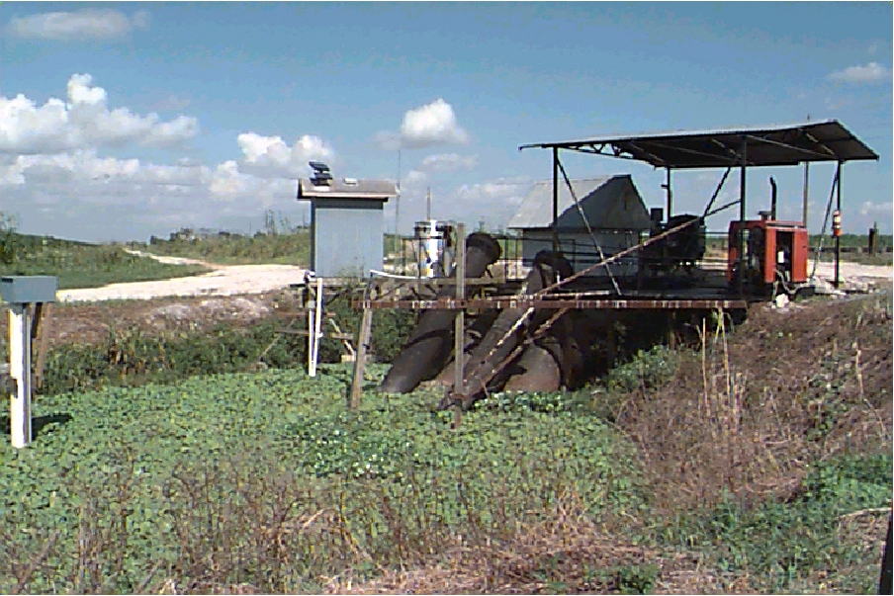
Particulate Phosphorus Sources
In-Stream Biological Growth (accounts for 85% of particulate P)
Canal Bed Erosion
Soil Erosion from Overland Flow
Bank Erosion from Channel Flow
Constitutes 40-60% of a Farm’s Annual P Load

Slide 41
Controlling Particulate P
Drainage flow velocity control
Floating aquatic weed control
Canal sediment removal

Slide 42
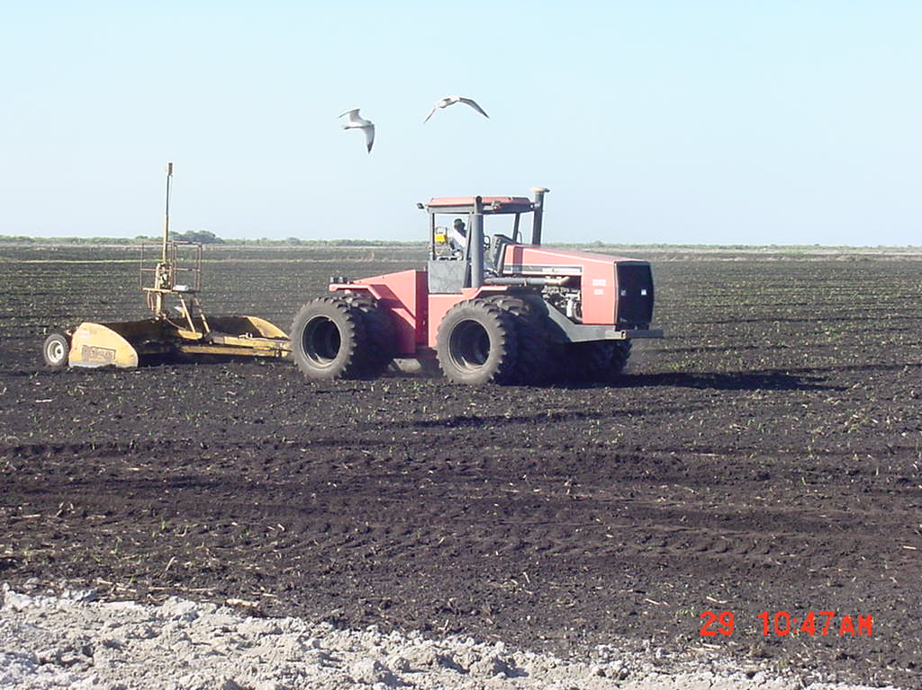
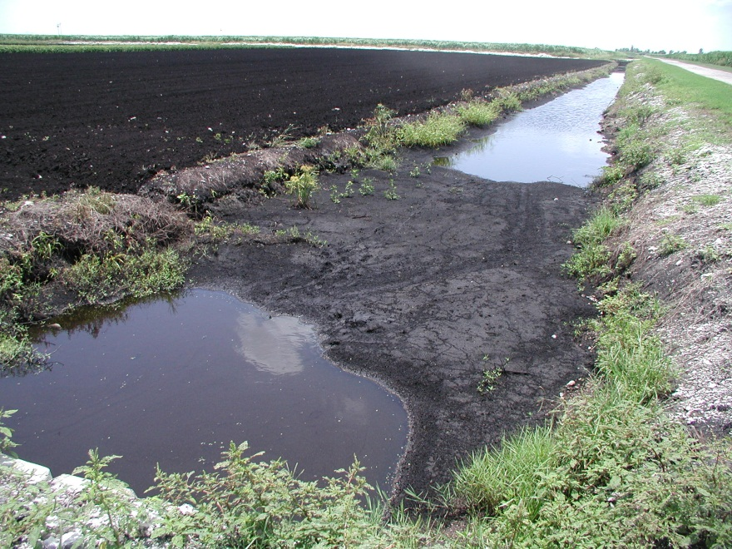
Land Leveling
Achieved by laser and GPS guided land-leveling equipment
BENEFITS
  Reduces sheet and rill erosion
  Improves water management
  Uniform field drainage reduces P loads
  Better cover crop yield
Notes:
No surface erosion
Uniform field drainage

Slide 43
Field Ditch Sediment Sump
BENEFITS
  Trap heavier sediments that have been deposited in field ditches during field preparation, by wind erosion, and by surface runoff
Maintenance
  Require frequent cleaning usually every other year
Notes:
Grower practices

Slide 44
Vegetation & Berms
Small raised berms parallel to the filed ditches and canal banks
Water is forced to percolate vertically
Field ditch bank berm minimizes field surface runoff
Main canal bank berm effectively lower road runoff into the canal which may contain residuals from fertilizer and pesticide applications
Notes:
Grower practices very effective under heavy rainfall

Slide 45
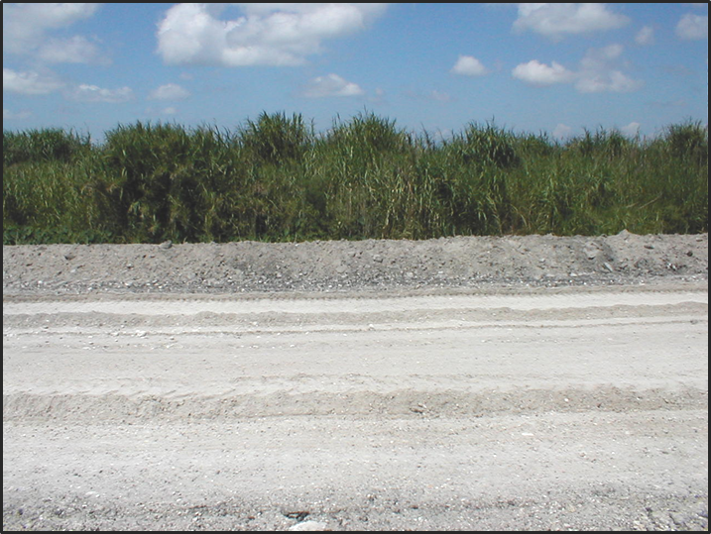
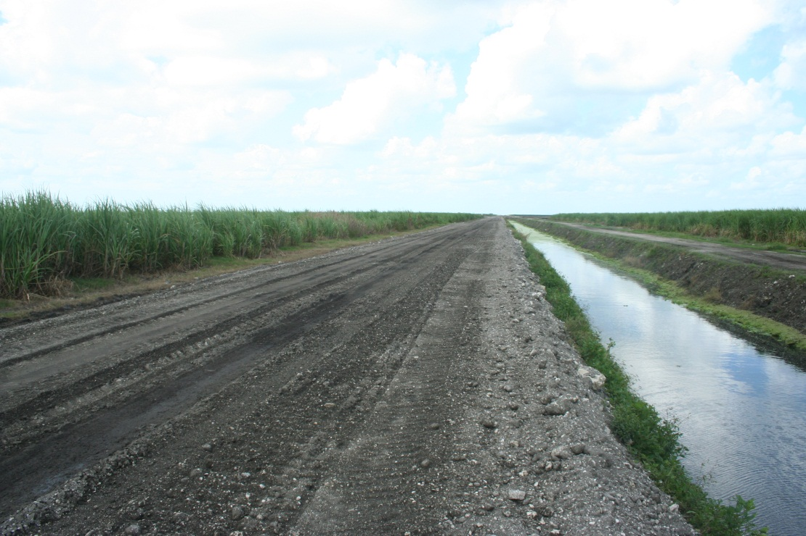
Ditch & Canal Bank Berms

Slide 46
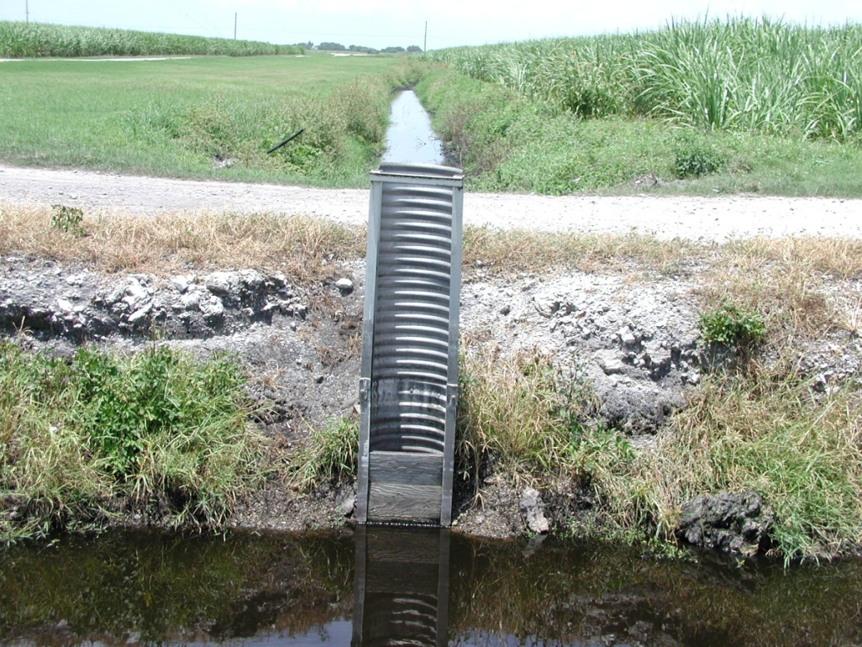
Riser Boards Near Pump Station
Installation of culverts with risers
Placement of flow-restraining boards
BENEFITS
Slow down drainage
Uniform drainage of the farther distances in the field
Minimal over-drainage
Slow velocity of water in ditches and canals
Marked reduction in the offsite sediment movement and the farm P loads
Notes:
Grower practices

Slide 47
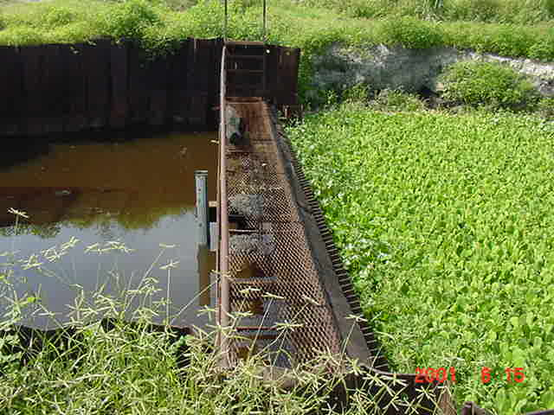
Trash Rakes & Weed Booms

Slide 48
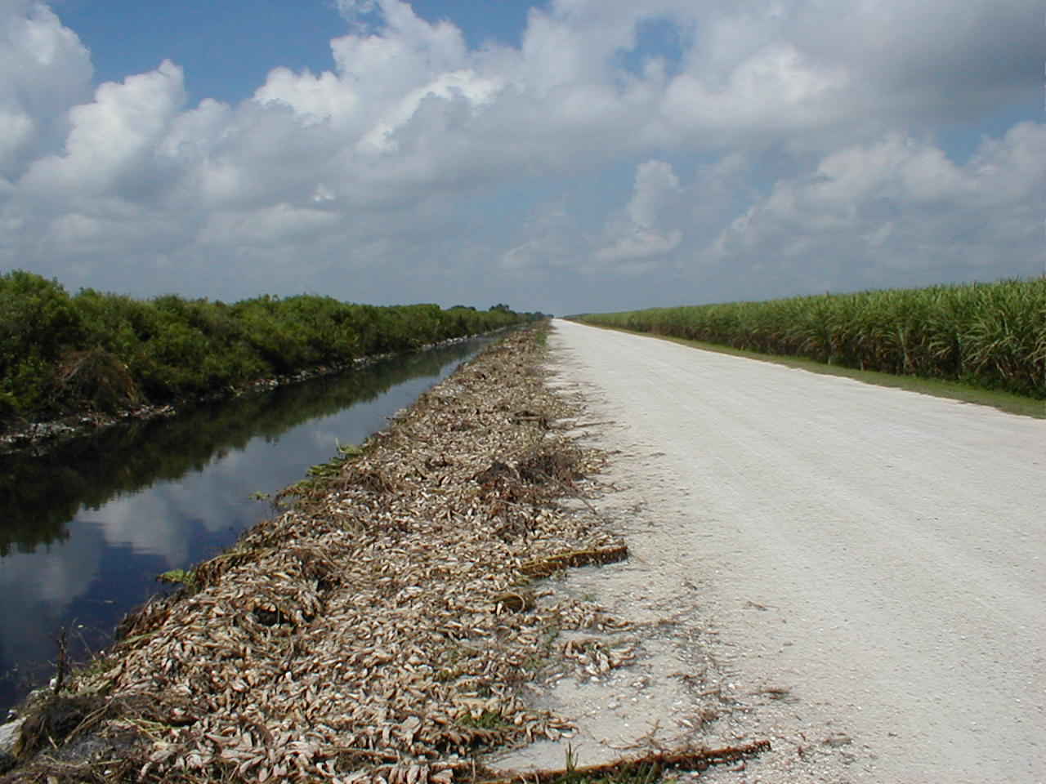
Removal of Aquatic Weeds

Slide 49
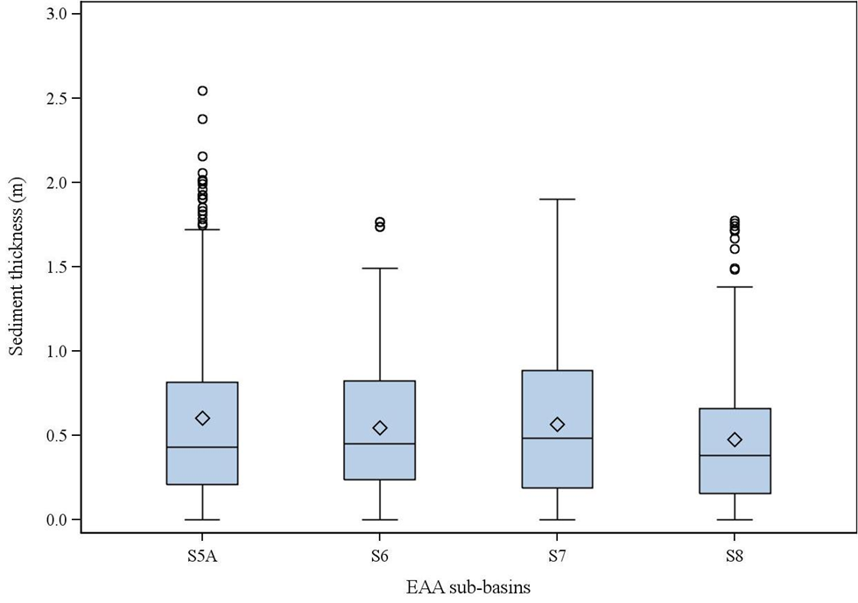
Regular Canal Cleaning Program
Sediment tends to accumulate in main drainage canals
Rich source of P
Expensive but very effective means of reducing offsite P movement
Should be conducted during quiescent conditions or if possible in conjunction with irrigation
Figure: Distribution of canal sediment thickness (m) of four EAA sub-basins farms(n=9) unpublished data; Daroub et al. 2010.

Slide 50
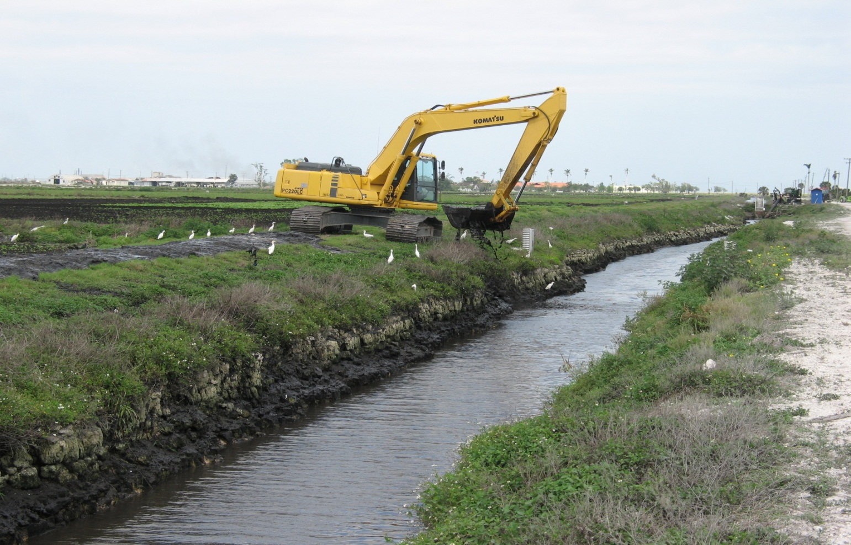
Regular Canal Cleaning

Slide 51
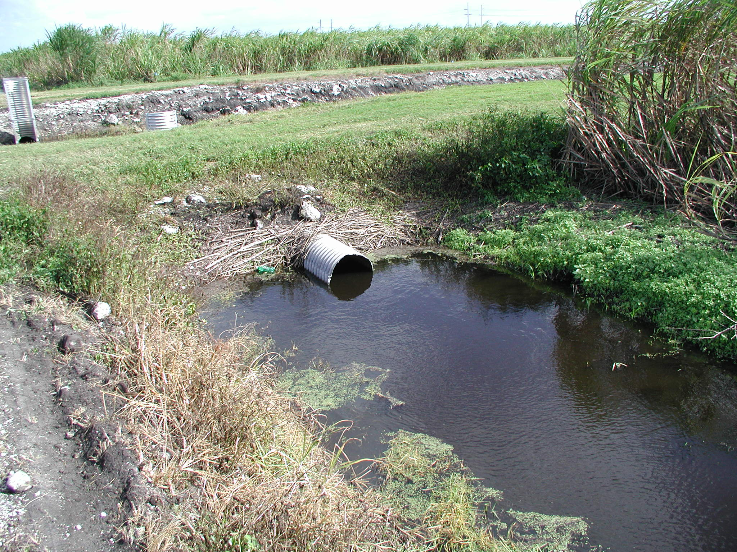
Raised Culverts

Slide 52
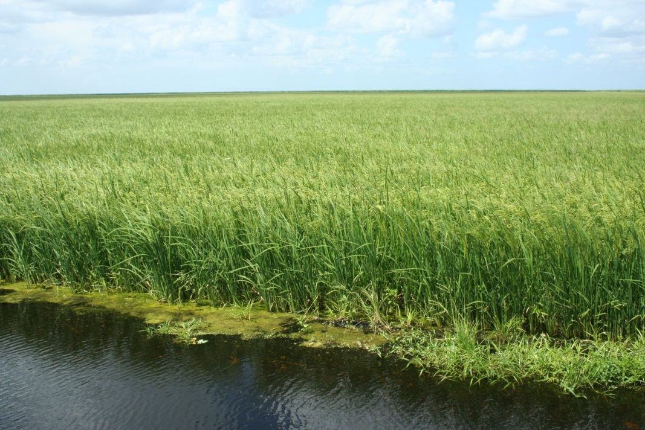
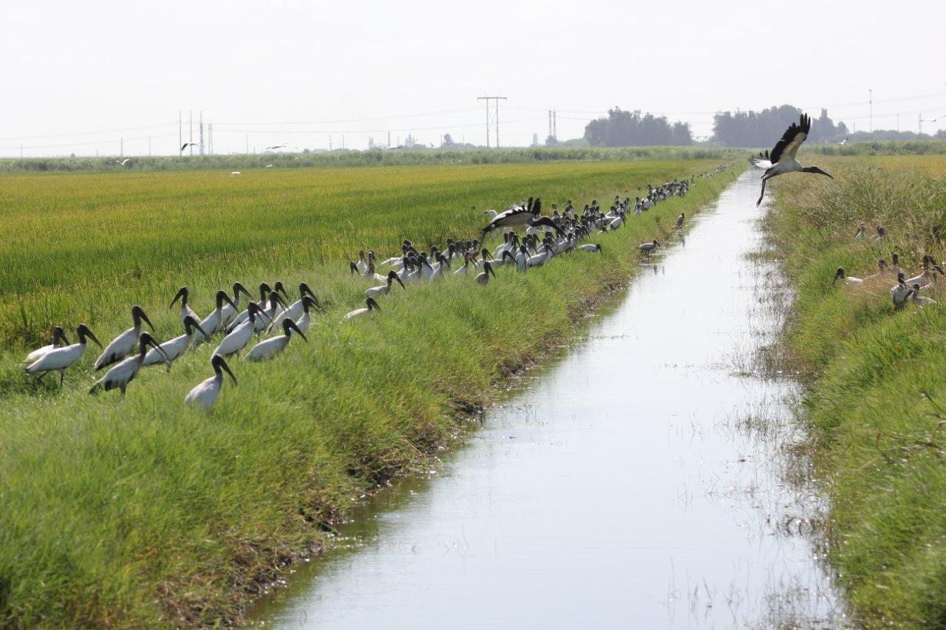
Cover Crop of rice
Minimizes soil erosion
Stops soil subsidence
Serves as drainage water storage pond
Provide refuge to wading birds such as Wood Stork
Notes:
Stop soil subsidence
Serves as drainage water storage pond

Slide 53
What Else??
The State of Florida is successfully implementing water quality improvements and lowering P levels in the Everglades bound waters, through the construction of Stormwater Treatment Areas (STAs)
At present, 65,000 acres, south of Lake Okeechobee have been converted to STAs

Slide 54
STAs function by accumulating P in sediments through uptake by emergent plants and submerged aquatic vegetation
Diagram courtesy of SFWMD

Slide 55
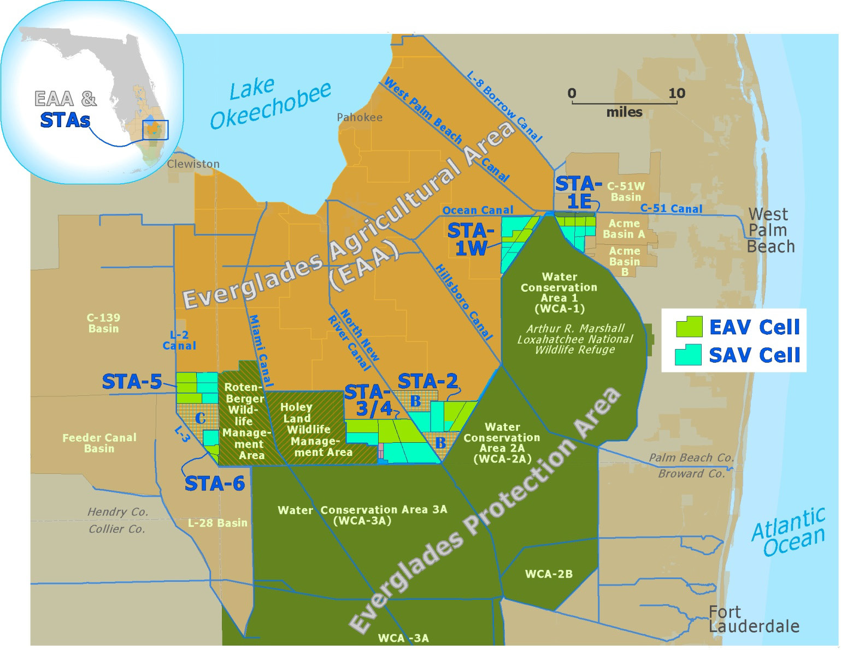
Diagram courtesy of SFWMD

Slide 56
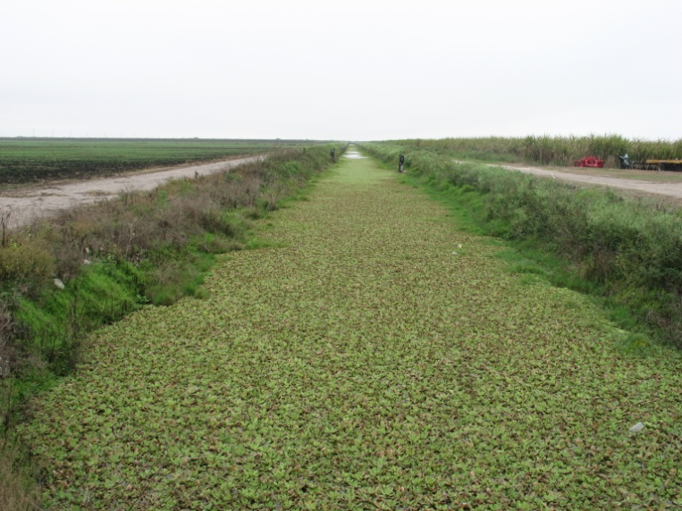
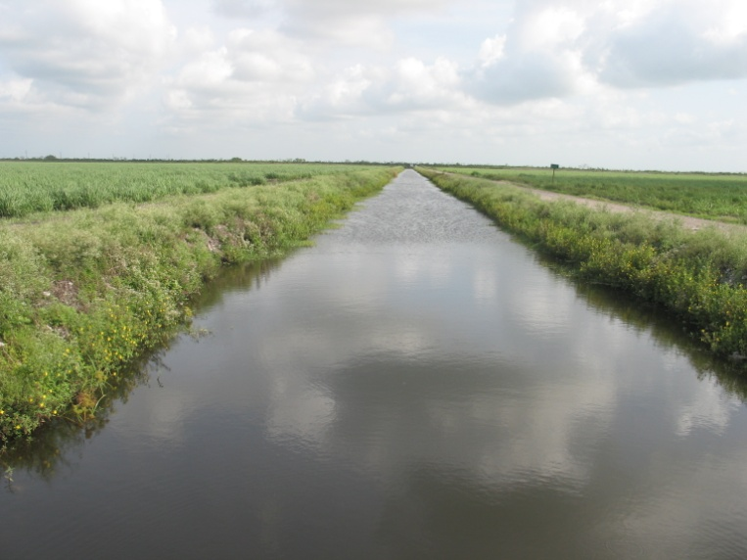
BMP-FAV Research Project
Objectives
1. Evaluate FAV management practices in the EAA farm canals for impact on farm drainage water phosphorus load.
2. Evaluate the effect of FAV management practices on P speciation of farm drainage water and canal sediment properties.
Use research results to develop a BMP for managing FAV in farm canals that further lowers farm P loads.
The goal is to provide growers an additional tool in their efforts to reduce off-farm P loading in the Everglades Agricultural Area.

Slide 57
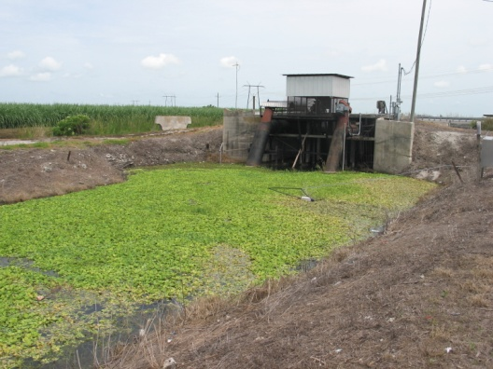
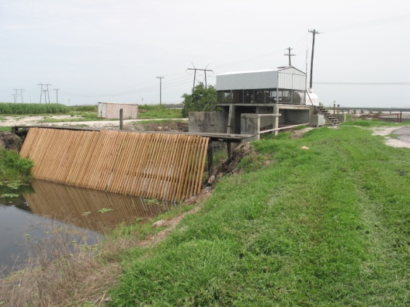
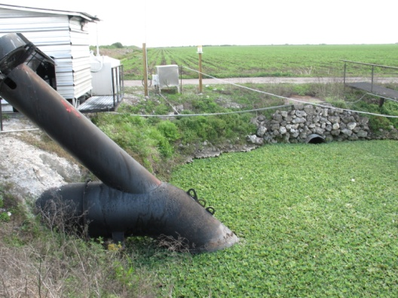

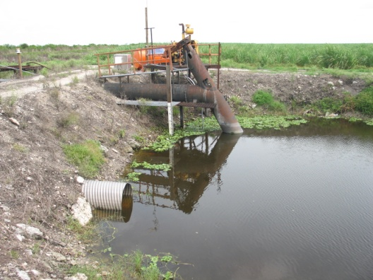
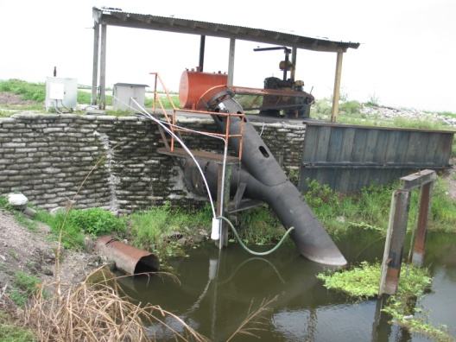
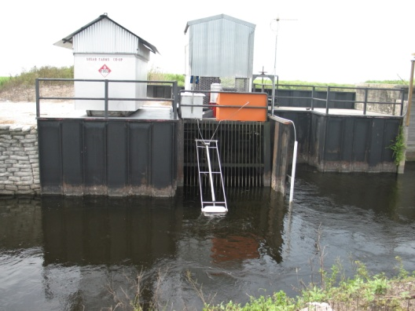
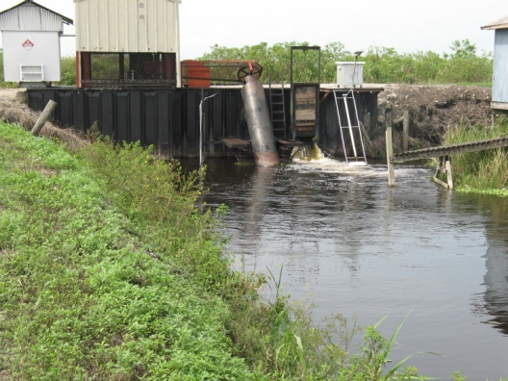
FAV Research Project
Methods
  Paired farms study (4 pairs)
  Farms approved by growers, advisory committee, and SFWMD
  Two pairs each in S-5A and S-6 sub basins
  2-yr calibration and 3-yr treatment periods
  Calculate changes after initiation of practices
  Improved vs. typical FAV control practices
0401
2501
3301
3302
6117
1813
4701
4702
Notes:
Need some methods text from SOW or annual report here…..

Slide 58
FAV Research Project
Farm Drainage Water
Drainage flow, P concentration, and P load monitored
Concentration measured from flow-composited refrigerated samples
Analyses: TP, TDP, SRP, TSS, pH, Ca
Relationship between a pair of farms determined for P load and other constituents for baseline and treatment period
Wet Season 2011 rainfall unevenly distributed – dry periods: Jul-Aug and Sep-Oct
Rainfall, drainage volume, and P load used in developing regression relationships for each farm pair

Slide 59
Results of WY2011 EAA Basin TP?
 | TP Load
Predicted TP load (adjusted for WY2011 rainfall amounts and monthly distribution relative to baseline period)1 | 219 mt
Target TP load (Predicted TP load reduced by 25 percent) | 164 mt
Limit TP load (upper 90% confidence limit for target load) | 231 mt
Observed WY2011 TP load from the EAA with BMPs implemented | 45 mt
WY2011 TP load reduction (relative difference between observed and predicted TP loads) | 79%
Three-year average TP load reduction | 62%
¹The baseline period of record is October 1978–September 1988 in accordance with EFA requirements.

Slide 60
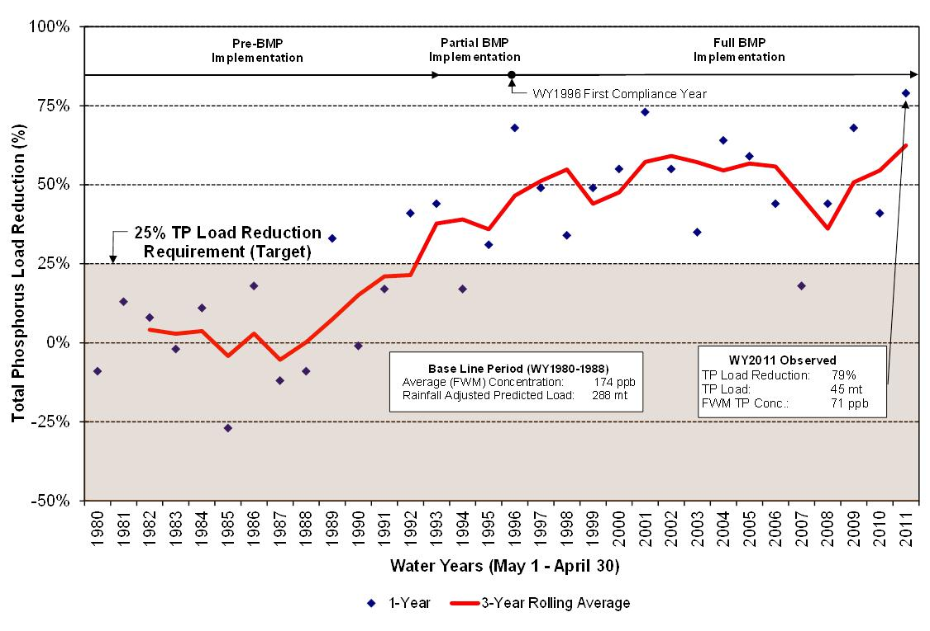
Are BMPs Working?

Slide 61
STA Performance Overview
SFWMD, 2012

Slide 62
STA Performance Summary
In WY 2011, the STAs received 735,165 acre-feet of water and retained 67.5 metric tons of TP.
Equates to a 79 % TP load reduction and decrease in FWTP from 94 to 20 ppb.

Slide 63
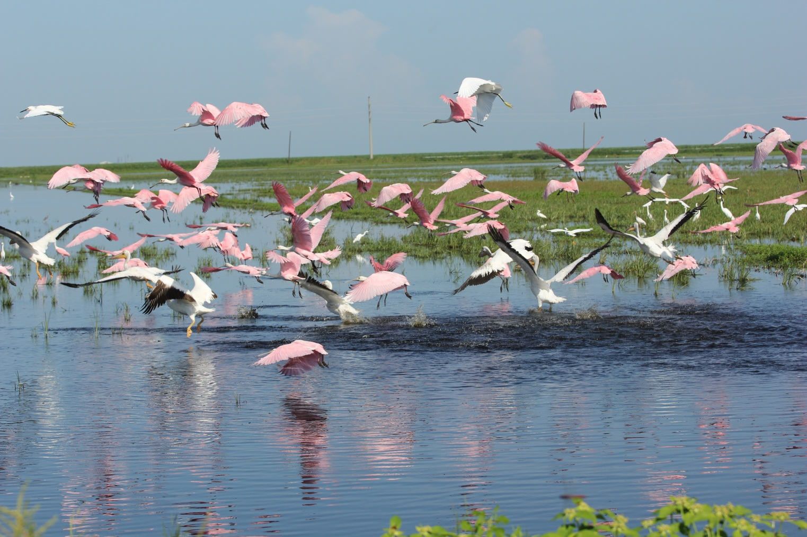
Thank you

